Slide 1
Christ in Creation
Praising with Other Creatures (Oct. 11)

Slide 2
Our Journey
Learning from Scripture to See Christ in Creation
Worshipping and Lamenting with the Community of Creation in Christ
Creation and Communion (Sept. 27)
Our Priesthood and Creation Care (Oct. 4)
Today: Praising with Other Creatures (Oct. 11)
Next: Human Sin, Creation's Lament, Sabbath Redemption (Oct. 18)
Loving Attentively and Practically in Christ

Slide 3
Today's Structure: Cooperative Discovery
Introduction (Josh)
There will be opportunities to contribute. Get ready!
Conversation (Barry Harvey and Josh)
Cooperative Discovery: YOUR Questions
During the introduction and conversation, enter questions that occur to you in Chat. (Please ask for help now if you don't know how to do this!)
We will take up these questions together in the last portion of class.

Slide 4
Keep in Mind: Questions Demanded by Our Previous Discussions
When discussing Norman Wirzba (Sept. 20), we stressed that the ministry of reconciliation means sacrificially joining Christ as His body in redressing the suffering of communities and creatures.

Slide 5
Keep in Mind: Questions Demanded by Our Previous Discussions
Today we discuss our participation in creation's worship of God.
How can this perspective inspire us to join Christ's ministry of reconciliation beyond the sanctuary?
Specifically, how can it inspire care not only for nonhuman creatures, but also for communities suffering from environmental and economic degradation and deprivation?

Slide 6
Consider the ways we involve creation in our worship. Let's list a few.
Bread and grape juice/wine (wheat, grapes, vines, soil+microorganisms+weather, human labor, etc.)
Large windows facing plants, environment: part of the worship is seeing the other creatures surrounding our worship, inspiring care for the earth (Dayspring and other churches)
Materials used in worship
Oak grove
St. Francis tree
Water for baptism
Stone facade at the front

Slide 7
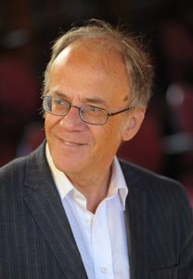
Praising Our Maker Together
Our worship always participates in the rest of creation.
What would it mean to see creation as a worshipping community?
Today's reading: Back to the Bauckham
"Praising our Maker Together" through "The Community of Creation" in The Bible and Ecology

Slide 8
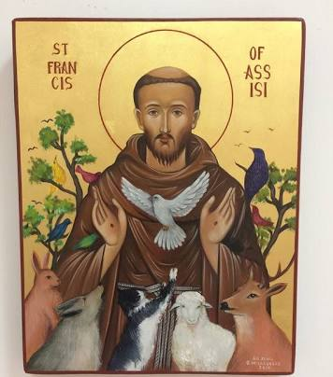
The Season of Creation (Sept. 1-Oct. 4) just ended with the Feast of St. Francis of Assisi (Oct. 4)
St. Francis saw creation as a community of worship. Consider "The Canticle of the Creatures" (a.k.a. "Canticle of the Sun").

Slide 9
The Season of Creation (Sept. 1-Oct. 4) just ended with the Feast of St. Francis of Assisi (Oct. 4)
Most High, all-powerful, good Lord,
Yours are the praises, the glory,
and the honor, and all blessing.
. . .
Praised be You, My Lord,
through Sister Moon and the stars,
in heaven You formed them
clear and precious and beautiful.
Praised be You, my Lord,
through Brother Wind,
and through the air, cloudy and serene,
and every kind of weather
through which you give sustenance to your creatures.
. . .

Slide 10
Praising Our Maker Together
Francis's Canticle is rooted in biblical tradition
Fifty Old Testament passages portray creation praising God (Fretheim, God and the World in the OT, pp. 267-68)
The New Testament picks up the theme (e.g., Phil 2:10, Rev. 5:13)
Bauckham highlights Psalm 148.

Slide 11
Psalm 148
Four Readers Needed!
Reader 1: Verses 1-4
Reader 2: Verses 5-6
Reader 3: Verses 7-12
Reader 4: Verses 13-14

Slide 12
Psalm 148
Verses 1-4
1. Praise the LORD!
Praise the LORD from the heavens;
Praise him in the heights!
2. Praise him, all his angels;
Praise him, all his host!
3. Praise him, sun and moon;
Praise him, all you shining stars!
4. Praise him, you highest heavens,
And you waters above the heavens!

Slide 13
Psalm 148
Verses 5-6
5. Let them praise the name of the Lord,
For he commanded and they were created.
6. He established them forever and ever;
He fixed their bounds, which cannot be passed.

Slide 14
Psalm 148
Verses 7-12
7. Praise the LORD from the earth,
You sea monsters and all deeps,
8. Fire and hail, snow and frost,
Stormy wind fulfilling his command!
9. Mountains and all hills,
Fruit trees and all cedars!
10. Wild animals and all cattle,
Creeping things and flying birds!
11. Kings of the earth and all peoples,
Princes and all rulers of the earth!
12. Young men and women alike,
Old and young together!

Slide 15
Psalm 148
Verses 13-14
13. Let them praise the name of the LORD,
For his name alone is exalted;
His glory is above earth and heaven.
14. He has raised up a horn for his people,
Praise for all his faithful,
For the people of Israel who are close to him.
Praise the LORD!

Slide 16
Psalm 148
Main Conclusions
Each member contributes to the choir, and if one is unable, missing, or unwilling, the whole song suffers (p. 79)
As the angels remind, humans are not the highest in the scale of value (p. 79)
Other creatures praise God by being what they are (p. 80)
Creation is not anthropocentric (human-centered, defined by humans), but a theocentric (God-centered, God-glorifying) community worship in which we invited to participate (pp. 81-82)

Slide 17
Psalm 148
Further Implications
Reciprocity, not Priestly Mediation? (pp. 83-86)
Nature Sacred—dedicated to God—not Divine (pp. 86-87)
Unique Members of a Community (pp. 87-92)

Slide 18
Questions Demanded by Our Previous Discussions
How can affirming our participation in creation's worship inspire us to join Christ's ministry of reconciliation beyond the sanctuary?
Specifically, how can it inspire care not only for nonhuman creatures, but also for communities suffering from environmental and economic degradation and deprivation?
Let's do a thought experiment.

Slide 19
From The Canticle of the Creatures
Praised be You, my Lord,
through our Sister Mother Earth,
who sustains and governs us,
and who produces various fruit
with colored flowers and herbs.
Praised be You, my Lord,
through those who give pardon for Your love,
and bear infirmity and tribulation.
Blessed are those who endure in peace
For by You, Most High, shall they be crowned.
http://franciscanseculars.com/the-canticle-of-the-creatures/

